Slide 1
Predicting Mortality of ICU Patients using Neural Networks
John Evans, Rajesh Pothamsetty, Mengnan Zhang
Georgia Institute of Technology – BDH6250

Slide 2
Overview
Motivation
Dataset
Design Considerations
Solution Architecture
Feature Selection
Model
Results
Lessons Learned and Future Work
Concluding Remarks

Slide 3
Motivation
ICU patients are at extreme risk of dying.
ICU mortality rates are as high as 25%.
Accounts for 20% of all health care costs in the US.
Reliably assessing severity of illness or trauma crucial to allocating ICU resources, and adjusting treatment plans.

Slide 4
Dataset
Multiparameter Intelligent Monitoring in Intensive Care (MIMIC III).
Provided by the Laboratory of Computational Physiology at MIT.
Contains 25,328 ICU stays from 2001 – 2012.
Includes mortality for 9974 patients that died in hospital.

Slide 5
Design Considerations
What features to use?
What model to use?
How to evaluate the model?
How to tune Hyperparameters?

Slide 6
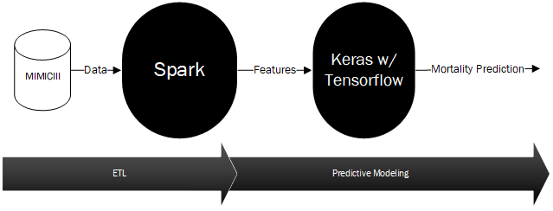
Solution Architecture

Slide 7
Feature Selection
Category | Count of Features
Chart Events with Numerical Score | 6463
Medication/ICD9/ Cumulative -ICUStay/Abnormal - Lab Values Count | 3
Binary Last Care Unit | 4
Length of Stay (LOS) | 1
Acute Care Phenotype Score | 1
SAPS | 17
Ecomorbidites | 30
Seven Distinct Feature Categories.
Phenotype scores computed from Harutyunyan et al.
SAPS computed using code provided by MIT.
Ecomorbidities map HADM_ID to ICUSTAY_ID.
Missing values masked.
Mortality based off of EXPIRE_FLAG for patients with a death associated with the ICU.

Slide 8
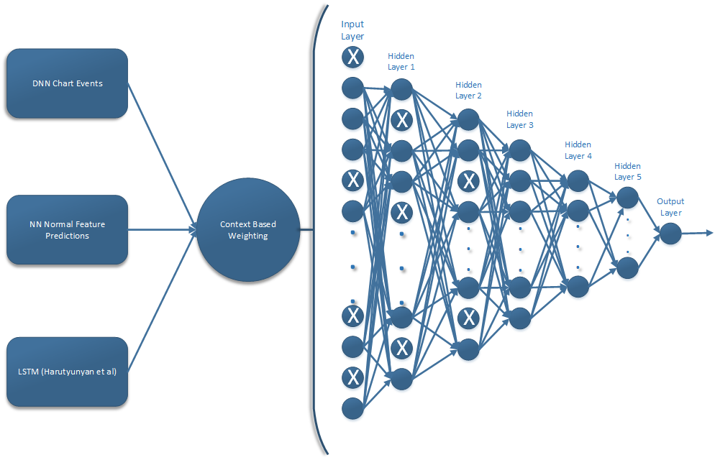
Model

Slide 9
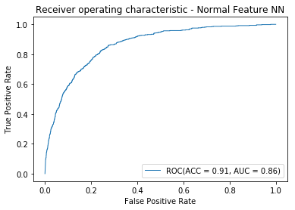
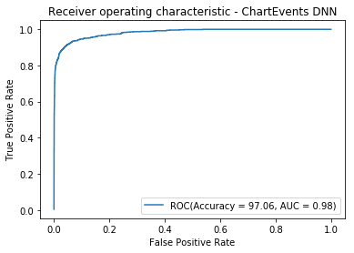
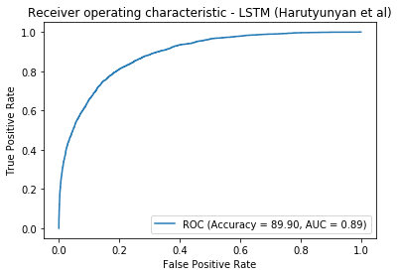
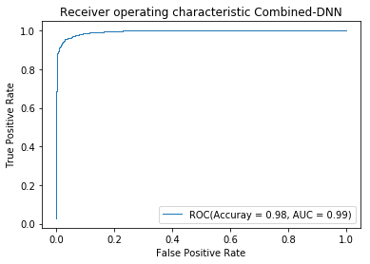
Results

Slide 10
Lessons Learned and Future Work
Loading Data
Sparse representation over dense representation
Batch inputs
Task Failures
Batch size
Checkpointing
Time Series
More timeseries variables

Slide 11
Concluding Remarks
Constructed an ensemble of neural networks to classify ICU mortality.
Keras implementation.
Achieved an accuracy of 98% and an AUC of 99% using chart events.
Possible improvements include batching inputs, and implementing checkpointing, and including more variables in timeseries data.

